Slide 1
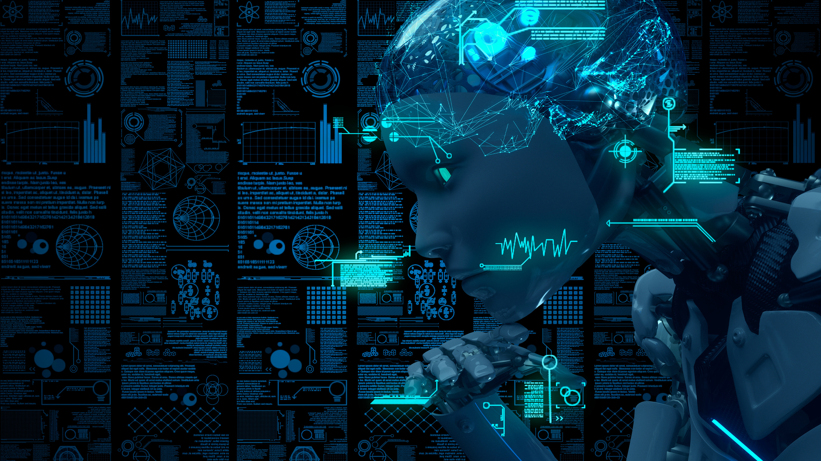
Artificial
Intelligence in the Classroom
The landscape of work, learning and online interaction is changing! How we respond will determine the success of our students!

Slide 2
RESOURCES
Find resources for this presentation by scanning the QR code. You can also email me or call me!
elizabeth.sigman@wusd.us
x5776
STEM Technology Integration Specialist
Alchesay High School
www.wusd.us/page/ahs.siggy

Slide 3
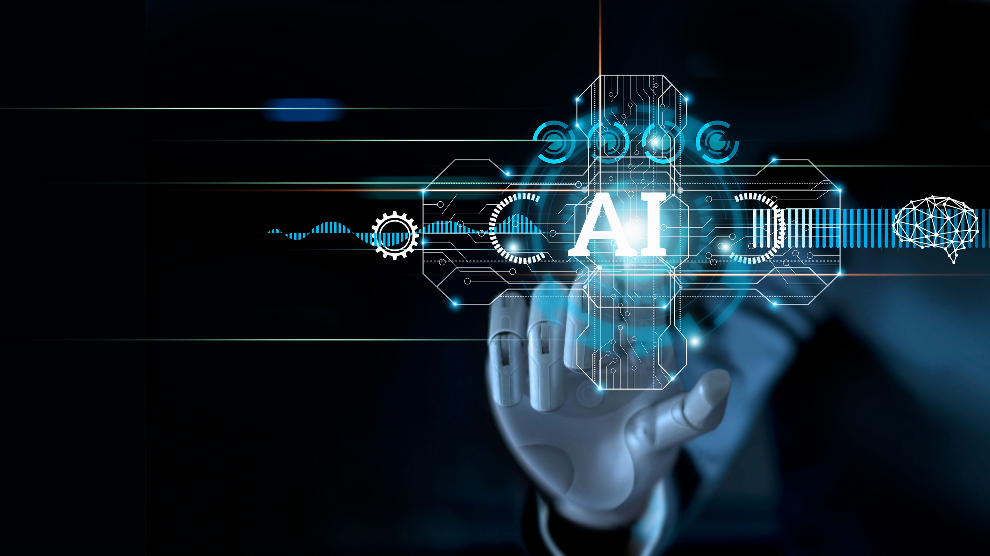
Me as an Artificial Intelligence

Slide 4
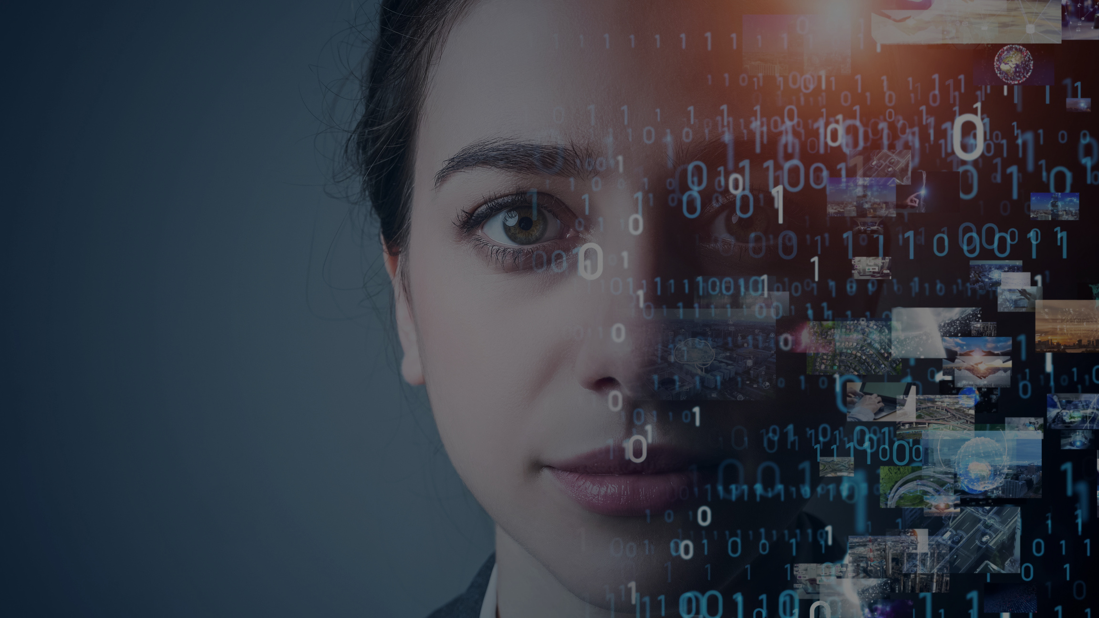
Midjourney
The website is Midjourney.com. It is one of the many new websites out there that will allow you artificial image generation. You have to create an account and it does cost money due to high demand and the processing cost of creating images so quickly. There is a pretty steep learning curve for this program but it does develop stunning images and there are lots of youtube tutorials. Think about the kinds of images you could create for classroom presentations.

Slide 5
Other AI Image Generators
Canva AI - Hit the magic button and type "Text to Image".
DALL-E 2 - by Open AI
Jasper AI
Dream by WOMBO
Nightcafe - has the feature of cool challenges that students could enter
Find an article with good information about the pros and cons of these and other AI image generators here.

Slide 6
What is the big deal about AI?
In November of 2022 Open AI, a small start up company with some big investors released the explosive Chat GPT, a generative AI or Large Language Model.
Large Language Models are algorithms that look at a huge number of online resources and use them to predict what word/phrase/idea would follow a prompt put in by a user.
chat.openai.com/chat

Slide 7
Chat GPT
1. Information from
online text (websites, libraries...etc
2. The system takes the input and processes it using mathematical models to match words to the words that commonly come next (predicting).
4. The model generates a UNIQUE response by predicting what words and phrases go with that prompt.
3. You input a prompt that provides the model with context.

Slide 8
Why is this important?
Your students are already using AI, if not for classroom assignments then for fun.
AI can help provide personalized learning experiences for students.
AI can help reduce the workload of teachers.
AI can help improve student engagement and motivation.

Slide 9
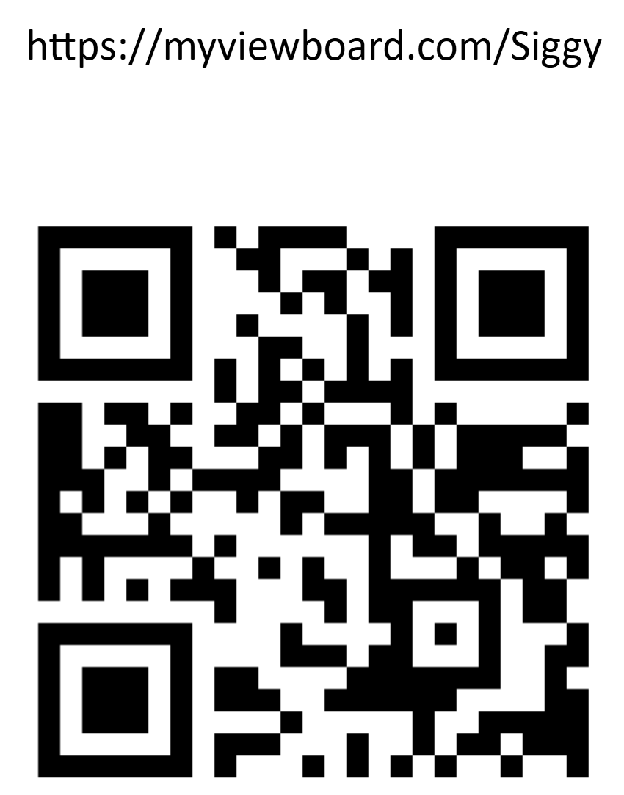
What are your experiences with AI in life or the classroom?

Slide 10
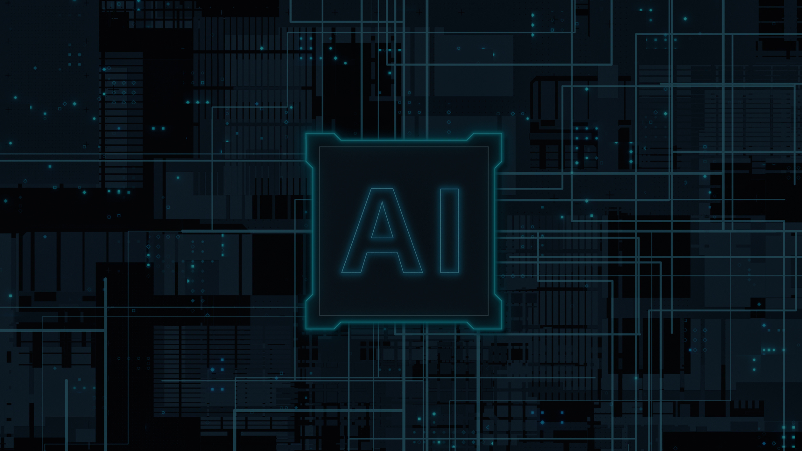
Helpful Vocabulary
Artificial Intelligence (AI): the simulation of human intelligence processes by machines, especially computer systems. These processes include learning (the acquisition of information and rules for using the information), reasoning (using the rules to reach approximate or definite conclusions), and self-correction.
Machine Learning (ML): the study of computer algorithms that improve automatically through experience. It is seen as a subset of artificial intelligence. ML algorithms build a mathematical model based on sample data
Natural Language Processing (NLP): the ability of a computer program to understand human language as it is spoken. NLP is an important part of AI, as it enables computers to process and understand spoken and written language, and to respond in an appropriate manner.

Slide 11
A Selective AI Timeline
The pursuit of AI has a long, intense history that has led us here.
1966
2014
2014
2017
ELIZA developed at MIT - simulates human speech
Google Brain project - deep learning AI research project
OpenAI is founded to pursue development of general AI
Transformer Models introduced - language processing models
2018
2022
2022-2023
Open AI introduces Generative Pre-trained Transformer (GPT)
OpenAI releases the Chat GPT Chatbot - LLMs Explode across the internet
Google, Meta, and Bing introduce their own chatbots and OpenAI releases APIs

Slide 12
Responses to AI in Education
Students use AI Chatbots to write papers and answer questions
Professors and Teachers attempt to develop policies surrounding AI
AI Generated Text Detectors
AI Tools using the OpenAI API created for computer and mobile devices.
Professors and Teachers begin using AI in the classroom to mixed reviews.
Professors and Teachers begin to adapt lessons for AI

Slide 13
Takeaways
AI in general and Chatbots are not going away. They will change the future of education, work, information access...everything.
Teachers need to plan for and include AI in your thinking as you design lessons.
AI Chatbots are fallible. The information they were trained on was not all correct so they are not always correct. Students still need to develop deep knowledge in a discipline to know the difference.
We can use it, make it work for us, or drive ourselves crazy trying to "defend against it".

Slide 14
Planning Instruction
Chatbots like ChatGPT are good for some things.
Analyze a student writing sample for creativity or for grammar usage…etc. You can even analyze it against a rubric.
They are wonderful at generating lists of things (good for generating ideas to springboard instruction or student thinking.
They can rephrase a text for different reading levels (just be sure to fact check it…they are not infallible).
They can give a relatively comprehensive explanation of a subject.
They are good at step-by-step instructions (again, fact check them).

Slide 15
Planning Instruction
Plan your instruction around higher level thinking skills.
Analysis
Evaluation
Creation
Plan project-based assignments that require students to USE the knowledge they are learning or to DEMONSTRATE the skill you are teaching in class.
This work can be done in your class where you can use Socratic discussion and questioning techniques to continually asses and ensure student learning (not just copying). If they wrote it, they should be able to tell you about it.

Slide 16
Planning Instruction
Allow students to use the AI to springboard their work. It is good for lists and ideas that students can develop further.
Students may be more comfortable discussing a topic or practicing for topic presentation with a chatbot.
There are many teacher AI resources that will help you with lesson planning, or at least help you fill in ideas for teaching.
Use AI image generators for graphics for presentations
You can use AI text detectors but there has not been one created yet that has not been fooled by an AI working from a really good prompt.

Slide 17
Referencing AI Chatbots
Teach students how to cite their use of AI chatbots.
The University of Waterloo has put out a useable guide for how to cite AI resources like chatbots:
See link here.
You can ask Chat GPT to cite where it got it’s information. Have students take that extra step to look at and evaluate the original resource.
Teach students about copyright ant it’s intersection with AI generated text and images.
Use an AI like Perplexity AI which automatically cites where it gets its information.

Slide 18
Resources
Ditch That Textbook has a pretty comprehensive list of new AI tools for teachers. Some of them are REALLY exciting!
Commonsense.org has a great list of tools that teachers can use to teach about AI and using it responsibly.
The International Society for Technology in Education has created many resources for AI in Education including videos and short courses/resources for teachers as well as students.

